Slide 1
Computer Organization Principles
School of Software, Dalian University of Technology
Chi Lin (林驰)
chilin@mail.dlut.edu.cn

Slide 2
Why do we need to study assembly language ?
Complicated
Boring
Tedious
Nearly useless
…

Slide 3
Great Reality #2: You’ve Got to Know Assembly
Carnegie Mellon
Chances are, you’ll never write programs in assembly
Compilers are much better & more patient than you are
But: Understanding assembly is key to machine-level execution model
Behavior of programs in presence of bugs
High-level language models break down
Tuning program performance
Understand optimizations done / not done by the compiler
Understanding sources of program inefficiency
Implementing system software
Compiler has machine code as target
Operating systems must manage process state
Creating / fighting malware
x86 assembly is the language of choice!

Slide 4


Reason Two: Programmer Rankings
Higher Level Language yields Low Level Programmer.
Niubility = Familiar with ( or Grasp) Computer Principles + Data Structure + Algorithm + C/C++
Struggle ! You can be Niubility with no friends.

Slide 5
Our Coverage
IA32
The traditional x86
x86-64/EM64T (Optional)
The emerging standard
Presentation
Book presents IA32 in Sections 3.1—3.12
Covers x86-64 in 3.13 (Optional)

Slide 6
Chapter Four: Instruction Systems
Instruction Encoding (指令编码)
Addressing Modes and Formats (寻址方式)
Instruction Usage (指令使用方法)
RISC

Slide 7
Chapter Four: Instruction Systems
Instruction Encoding (指令编码)
Addressing Modes and Formats(寻址方式)
Instruction Usage (指令使用方法)
RISC

Slide 8
Chap 4.1 Instruction Encoding
Machine Instruction Characteristics
Types of Operands (操作数类型)
Types of Operations (指令操作种类)
Examples

Slide 9
Chap 4.1 Instruction Encoding
Machine Instruction Characteristics
Types of Operands
Types of Operations
Examples

Slide 10
Definition of Instruction Set(指令集)
The operation of the processor is determined by the instructions it executes, referred to as machine instructions or computer instructions.
The collections of different instructions that the processor can execute is referred to as the processor’s instruction set.

Slide 11
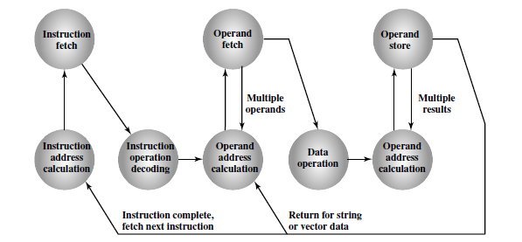
Instruction Cycle State Diagram

Slide 12
Elements of a instruction
Operation code: Specifies the operation to be performed (e.g., ADD, I/O). The operation is specified by a binary code, known as the operation code, or opcode.
Source operand reference: The operation may involve one or more source operands, that is, operands that are inputs for the operation.
Result operand reference: The operation may produce a result.
Next instruction reference: This tells the processor where to fetch the next instruction after the execution of this instruction is complete.

Slide 13
Instruction Representation
Within the computer, each instruction is represented by a sequence of bits. The instruction is divided into fields, corresponding to the constituent elements of the instruction.
During instruction execution, an instruction is read into an instruction register (IR) in the processor. The processor must be able to extract the data from the various instruction fields to perform the required operation.

Slide 14
Opcodes
Opcodes are represented by abbreviations. Common examples include
ADD Add
SUB Subtract
MUL Multiply
DIV Divide
LOAD Load data from memory
STOR Store data to memory
Operands are also represented symbolically. For example, the instruction

Slide 15
High-Level Language To Low Level
How to convert it into assembly language ?
X = X + Y (X=513, Y=514)
Load a register with the contents of memory location 513.
Add the contents of memory location 514 to the register.
Store the contents of the register in memory location 513.

Slide 16
Turning C into Object Code
Code in files p1.c p2.c
Compile with command: gcc –O1 p1.c p2.c -o p
Use basic optimizations (-O1)
Put resulting binary in file p
text
C program (p1.c p2.c)
Compiler (gcc -S)
text
Asm program (p1.s p2.s)
Assembler (gcc or as)
binary
Object program (p1.o p2.o)
Static libraries (.a)
Linker (gcc or ld)
binary
Executable program (p)

Slide 17
Compiling Into Assembly
C Code
Generated IA32 Assembly
int sum(int x, int y)
{
int t = x+y;
return t;
}
sum:
pushl %ebp
movl %esp,%ebp
movl 12(%ebp),%eax
addl 8(%ebp),%eax
popl %ebp
ret
Some compilers use instruction “leave”
Obtain with command
/usr/local/bin/gcc –O1 -S code.c
Produces file code.s

Slide 18
Data Types
“Integer” data of 1, 2, or 4 bytes
Data values
Addresses (untyped pointers)
Floating point data of 4, 8, or 10 bytes
No aggregate types such as arrays or structures
Just contiguously allocated bytes in memory

Slide 19
Instruction types
Data processing: Arithmetic and logic instructions.
Data storage: Movement of data into or out of register and or memory locations
Data movement: I/O instructions
Control: Test and branch instruction

Slide 20
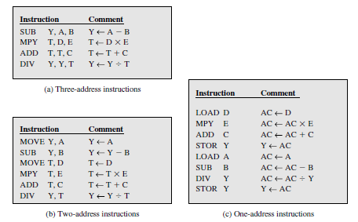
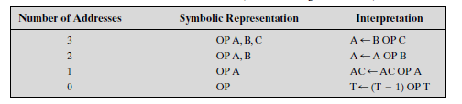
Number of Addresses

Slide 21
Trade-offs of the number of addresses
More addresses
Long execution time
More complex program
Faster (Register vs. memory)
Flexibility
Fewer addresses
More primitive
Require a less complex processor
Short length of instructions
Most computers employ a mixture of two- and three address instructions

Slide 22
Instruction Set Design
One of the most interesting, and most analyzed, aspects of computer design is instruction set design.
The design of an instruction set is very complex because it affects so many aspects of the computer system. The instruction set defines many of the functions performed by the processor and thus has a significant effect on the implementation of the processor.
The instruction set is the programmer’s means of controlling the processor. Thus, programmer requirements must be considered in designing the instruction set.

Slide 23
Instruction Set Design
Operation repertoire(操作种类): How many and which operations to provide, and how complex operations should be ?
Data types: The various types of data upon which operations are performed.
Instruction format: Instruction length (in bits), number of addresses, size of various fields, and so on.

Slide 24
Instruction Set Design
Registers: Number of processor registers that can be referenced by instructions, and their use
Addressing: The mode or modes by which the address of an operand is specified

Slide 25
Chap 4.1 Instruction Encoding
Machine Instruction Characteristics
Types of Operands
Types of Operations
Examples

Slide 26
Types of Operands（操作数）
Machine instructions operate on data. The most important general categories of data are:
Memory(内存地址)
Register(寄存器)
Immediate(立即数)

Slide 27
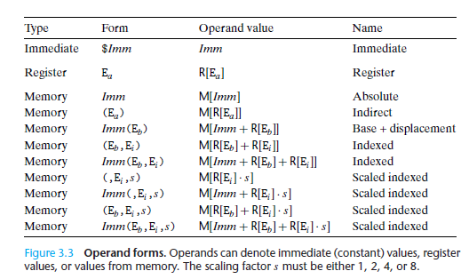
Operands Forms

Slide 28
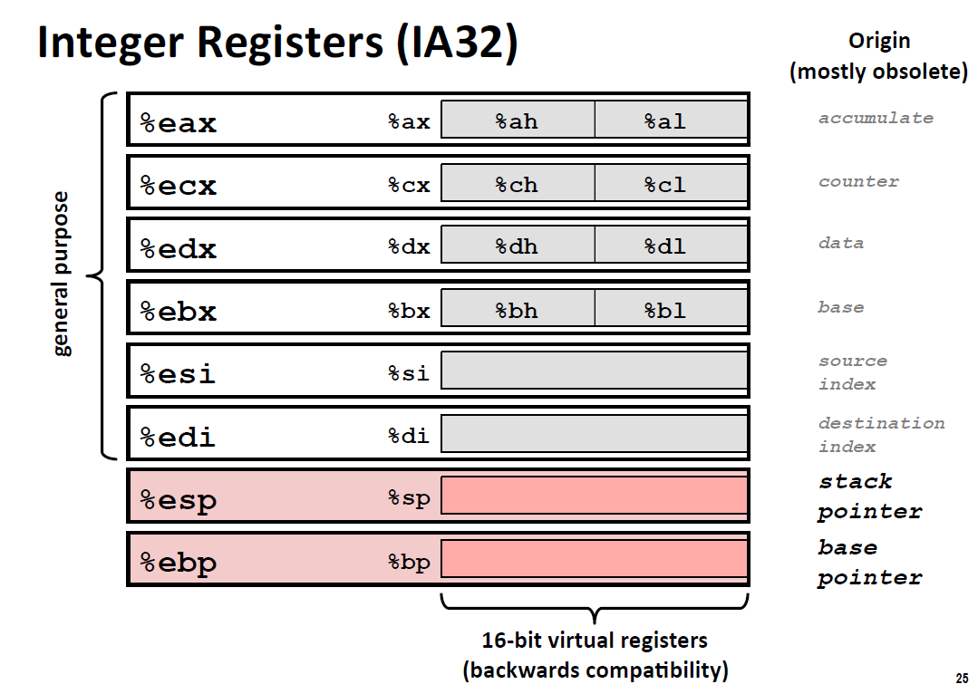

Slide 29
Moving Data: IA32
%eax
%ecx
Moving Data
movl Source, Dest:
Operand Types
Immediate: Constant integer data
Example: $0x400, $-533
Like C constant, but prefixed with ‘$’
Encoded with 1, 2, or 4 bytes
Register: One of 8 integer registers
Example: %eax, %edx
But %esp and %ebp reserved for special use
Others have special uses for particular instructions
Memory: 4 consecutive bytes of memory at address given by register
Simplest example: (%eax)
Various other “address modes”
%edx
%ebx
%esi
%edi
%esp
%ebp

Slide 30
movl Operand Combinations
Source
Dest
Src,Dest
C Analog
Reg
movl $0x4,%eax
temp = 0x4;
Imm
Mem
movl $-147,(%eax)
*p = -147;
Reg
movl %eax,%edx
temp2 = temp1;
movl
Reg
Mem
movl %eax,(%edx)
*p = temp;
Mem
Reg
movl (%eax),%edx
temp = *p;
Cannot do memory-memory transfer with a single instruction

Slide 31
Simple Memory Addressing Modes
Normal (R) Mem[Reg[R]]
Register R specifies memory address movl (%ecx),%eax
Displacement D(R) Mem[Reg[R]+D]
Register R specifies start of memory region
Constant displacement D specifies offset movl 8(%ebp),%edx

Slide 32
Chap 4.1 Instruction Encoding
Machine Instruction Characteristics
Types of Operands
Types of Operations
Examples

Slide 33
Assembly Characteristics: Operations
Perform arithmetic function on register or memory data
Transfer data between memory and register
Load data from memory into register
Store register data into memory
Transfer control
Unconditional jumps to/from procedures
Conditional branches

Slide 34
Types of Operations (opcode)
The number of different opcodes varies widely from machine to machine. However, the same general types of operations are found on all machines. A useful and typical categorization is the following:
Data movement
Arithmetic & Logical
State Control & Settings
Jumping

Slide 35
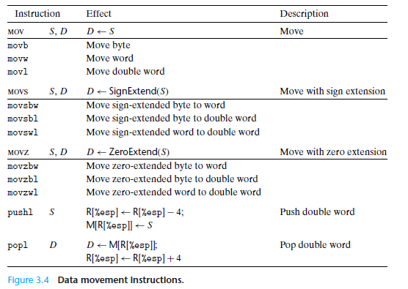
Data Movement Instruction

Slide 36
Data Movement Instruction
Among the most heavily used instructions are those that copy data from one location to another. The generality of the operand notation allows a simple data movement instruction to perform what in many machines would require a number of instructions

Slide 37
Data Transfer & Data Movement Instruction
The location of the source and destination operands must be specified. Each location could be memory, a register, or the top of the stack.
The length of data to be transferred must be indicated
The mode of addressing for each operand must be specified.

Slide 38
Mov class
The instructions in the mov class copy their source values to their destinations.
The source operand designates a value that is immediate, stored in a register, or stored in memory.
The destination operand designates a location that is either a register or a memory address.

Slide 39
Push & Pop
We add data to a stack via a push operation and remove it via a pop operation, with the property that the value popped will always be the value that was most recently pushed and is still on the stack.
First in last out

Slide 40
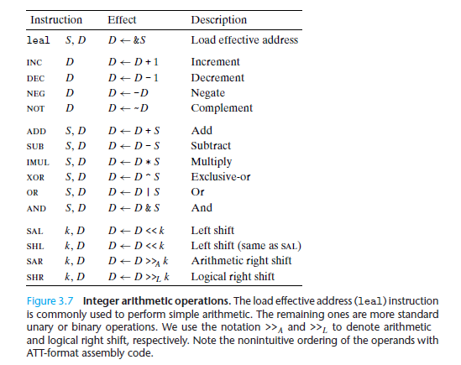
Integer Arithmetic Operations

Slide 41
Arithmetic Instruction
The execution of an arithmetic instruction may involve data transfer operations to position operands for input to the ALU, and to deliver the output of the ALU.
E.g. ADD %ESP, %EAX

Slide 42
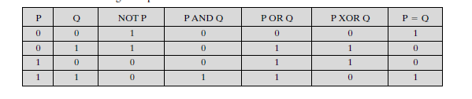
Logical Instruction

Slide 43
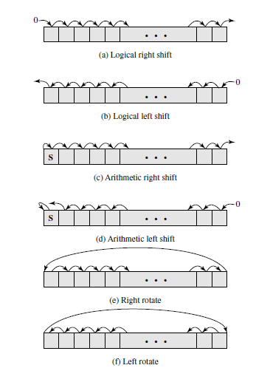
Shift instructions

Slide 44
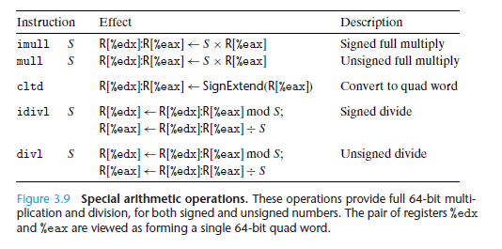
Special Arithmetic Operations

Slide 45
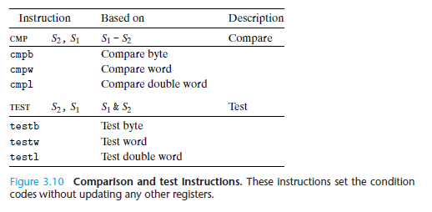
Comparison and Test Instructions

Slide 46
Condition Code Register
In addition to the integer registers, the CPU maintains a set of single-bit condition code registers describing attributes of the most recent arithmetic or logical operation. These registers can then be tested to perform conditional branches. The most useful condition codes are:
CF: Carry Flag. The most recent operation generated a carry out of the most significant bit. Used to detect overflow for unsigned operations.
ZF: Zero Flag. The most recent operation yielded zero.
SF: Sign Flag. The most recent operation yielded a negative value.
OF: Overflow Flag. The most recent operation caused a two’s-complement overflow—either negative or positive.

Slide 47
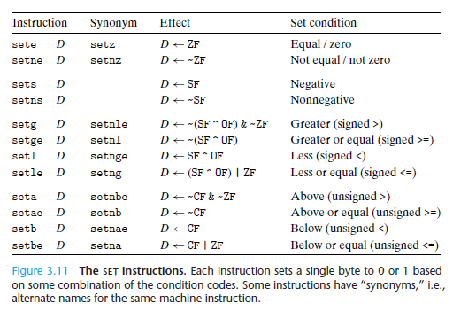
The Set Instructions

Slide 48

Jumping Instruction
A jump instruction can cause the execution to switch to a completely new position in the program. These jump destinations are generally indicated in assembly code by a label.

Slide 49
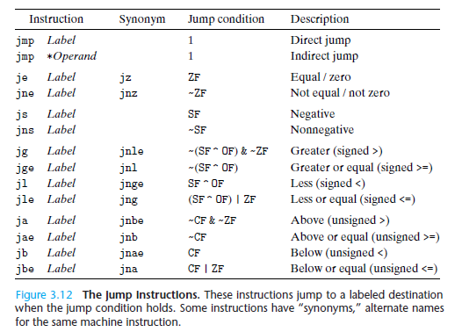
The Jumping Instruction/ branch Instruction

Slide 50
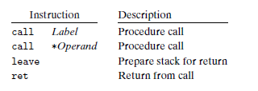
Transferring Control
The call instruction has a target indicating the address of the instruction where the called procedure starts. Like jumps, a call can either be direct or indirect.
The ret instruction pops an address off the stack and jumps to this location. The proper use of this instruction is to have prepared the stack so that the stack pointer points to the place where the preceding call instruction stored its return address.

Slide 51
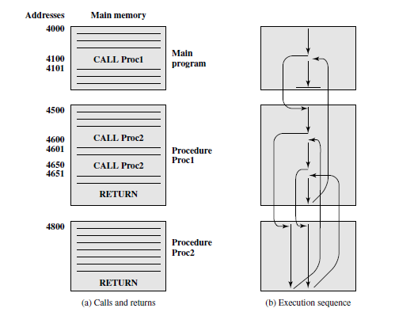
Example of Nested Procedures (嵌套函数)

Slide 52
Chap 4.1 Instruction Encoding
Machine Instruction Characteristics
Types of Operands
Types of Operations
Examples

Slide 53
Using Simple Addressing Modes
swap:
pushl %ebp
movl %esp,%ebp
pushl %ebx
movl 8(%ebp), %edx
movl 12(%ebp), %ecx
movl (%edx), %ebx
movl (%ecx), %eax
movl %eax, (%edx)
movl %ebx, (%ecx)
popl %ebx
popl %ebp
ret
void swap(int *xp, int *yp)
{
int t0 = *xp;
int t1 = *yp;
*xp = t1;
*yp = t0;
}
Set
Up
Body
Finish

Slide 54
Using Simple Addressing Modes
swap:
pushl %ebp
movl %esp,%ebp
pushl %ebx
movl 8(%ebp), %edx
movl 12(%ebp), %ecx
movl (%edx), %ebx
movl (%ecx), %eax
movl %eax, (%edx)
movl %ebx, (%ecx)
popl %ebx
popl %ebp
ret
void swap(int *xp, int *yp)
{
int t0 = *xp;
int t1 = *yp;
*xp = t1;
*yp = t0;
}
Set
Up
Body
Finish

Slide 55
Understanding Swap
•
•
•
void swap(int *xp, int *yp)
{
int t0 = *xp;
int t1 = *yp;
*xp = t1;
*yp = t0;
}
Stack
(in memory)
Offset
12
yp
8
xp
4
Rtn adr
0
Old %ebp
%ebp
-4
Old %ebx
%esp
Register Value
%edx xp
%ecx yp
%ebx t0
%eax t1
movl 8(%ebp), %edx # edx = xp
movl 12(%ebp), %ecx # ecx = yp
movl (%edx), %ebx # ebx = *xp (t0)
movl (%ecx), %eax # eax = *yp (t1)
movl %eax, (%edx) # *xp = t1
movl %ebx, (%ecx) # *yp = t0

Slide 56
Understanding Swap
Address
123
0x124
456
0x120
0x11c
%eax
0x118
%edx
Offset
0x114
%ecx
yp
12
0x120
0x110
xp
8
0x124
0x10c
%ebx
4
Rtn adr
0x108
%esi
%ebp
0
0x104
%edi
-4
0x100
%esp
movl 8(%ebp), %edx # edx = xp
movl 12(%ebp), %ecx # ecx = yp
movl (%edx), %ebx # ebx = *xp (t0)
movl (%ecx), %eax # eax = *yp (t1)
movl %eax, (%edx) # *xp = t1
movl %ebx, (%ecx) # *yp = t0
%ebp
0x104

Slide 57
Understanding Swap
Address
123
0x124
456
0x120
0x11c
%eax
0x118
%edx
0x124
Offset
0x114
yp
12
0x120
%ecx
0x120
0x110
xp
8
0x124
0x10c
%ebx
4
Rtn adr
0x108
%esi
%ebp
0
0x104
%edi
-4
0x100
%esp
movl 8(%ebp), %edx # edx = xp
movl 12(%ebp), %ecx # ecx = yp
movl (%edx), %ebx # ebx = *xp (t0)
movl (%ecx), %eax # eax = *yp (t1)
movl %eax, (%edx) # *xp = t1
movl %ebx, (%ecx) # *yp = t0
%ebp
0x104

Slide 58
Understanding Swap
Address
123
0x124
456
0x120
0x11c
%eax
0x118
%edx
0x124
Offset
0x114
%ecx
0x120
yp
12
0x120
0x110
xp
8
0x124
0x124
0x10c
%ebx
4
Rtn adr
0x108
%esi
%ebp
0
0x104
%edi
-4
0x100
%esp
movl 8(%ebp), %edx # edx = xp
movl 12(%ebp), %ecx # ecx = yp
movl (%edx), %ebx # ebx = *xp (t0)
movl (%ecx), %eax # eax = *yp (t1)
movl %eax, (%edx) # *xp = t1
movl %ebx, (%ecx) # *yp = t0
%ebp
0x104

Slide 59
Understanding Swap
Address
123
0x124
456
456
0x120
0x11c
%eax
0x118
%edx
0x124
Offset
0x114
%ecx
0x120
yp
12
0x120
0x110
xp
8
0x124
0x10c
%ebx
123
4
Rtn adr
0x108
%esi
%ebp
0
0x104
%edi
-4
0x100
%esp
movl 8(%ebp), %edx # edx = xp
movl 12(%ebp), %ecx # ecx = yp
movl (%edx), %ebx # ebx = *xp (t0)
movl (%ecx), %eax # eax = *yp (t1)
movl %eax, (%edx) # *xp = t1
movl %ebx, (%ecx) # *yp = t0
%ebp
0x104

Slide 60
Understanding Swap
Address
123
123
0x124
456
0x120
0x11c
%eax
456
0x118
%edx
0x124
Offset
0x114
%ecx
0x120
yp
12
0x120
0x110
xp
8
0x124
0x10c
%ebx
123
4
Rtn adr
0x108
%esi
%ebp
0
0x104
%edi
-4
0x100
%esp
movl 8(%ebp), %edx # edx = xp
movl 12(%ebp), %ecx # ecx = yp
movl (%edx), %ebx # ebx = *xp (t0)
movl (%ecx), %eax # eax = *yp (t1)
movl %eax, (%edx) # *xp = t1
movl %ebx, (%ecx) # *yp = t0
%ebp
0x104

Slide 61
Understanding Swap
Address
456
0x124
456
0x120
0x11c
%eax
456
456
0x118
%edx
0x124
Offset
0x114
%ecx
0x120
yp
12
0x120
0x110
xp
8
0x124
0x10c
%ebx
123
123
4
Rtn adr
0x108
%esi
%ebp
0
0x104
%edi
-4
0x100
%esp
movl 8(%ebp), %edx # edx = xp
movl 12(%ebp), %ecx # ecx = yp
movl (%edx), %ebx # ebx = *xp (t0)
movl (%ecx), %eax # eax = *yp (t1)
movl %eax, (%edx) # *xp = t1
movl %ebx, (%ecx) # *yp = t0
%ebp
0x104

Slide 62
Understanding Swap
Address
456
0x124
123
0x120
0x11c
%eax
456
0x118
%edx
0x124
Offset
0x114
%ecx
0x120
yp
12
0x120
0x110
xp
8
0x124
0x10c
%ebx
123
123
4
Rtn adr
0x108
%esi
%ebp
0
0x104
%edi
-4
0x100
%esp
movl 8(%ebp), %edx # edx = xp
movl 12(%ebp), %ecx # ecx = yp
movl (%edx), %ebx # ebx = *xp (t0)
movl (%ecx), %eax # eax = *yp (t1)
movl %eax, (%edx) # *xp = t1
movl %ebx, (%ecx) # *yp = t0
%ebp
0x104

Slide 63
Homework
Review 3.1-3.3
Practice Problem 3.1

Slide 64
Thank You

